Slide 1

NA - ACCIDENTO
AUTOMATED HOME SECURITY SYSTEM

Slide 2
Why gas leaks are dangerous?
Gas leak detection services are necessary mainly for health reasons. Combustible gases can start fires or cause explosions in homes and workplaces, injuring you, family members, friends or workers. Gas leaks can also cause health issues in the long term from gradual exposure. Some gas leaks are even silent killers.

Slide 3
Abstract
The main aim of this project is to monitor and secure the house 24/7
In this project, the system monitors for liquid petroleum gas (LPG) leakage to avoid fire accidents, providing home safety measurements where the security has been an important issue.

Slide 4
Cntd…
The system detects the LPG leakage using a gas sensor and flames by a flame sensor that alerts the consumer about the gas leakage by sending SMS with the help of GSM module which is connected preprogrammed microcontroller.
the system shuts off gas supply avoiding any chances of explosions.
The system now also starts an exhaust fan to suck out all the leaked gas or smoke.
System also secures the house at night times when we are asleep or at times when we lock the door and go somewhere outside.
It detects if someone are outside of the house or if someone entered into house by breaking the door and sends alert SMS to the respective people accordingly.

Slide 5

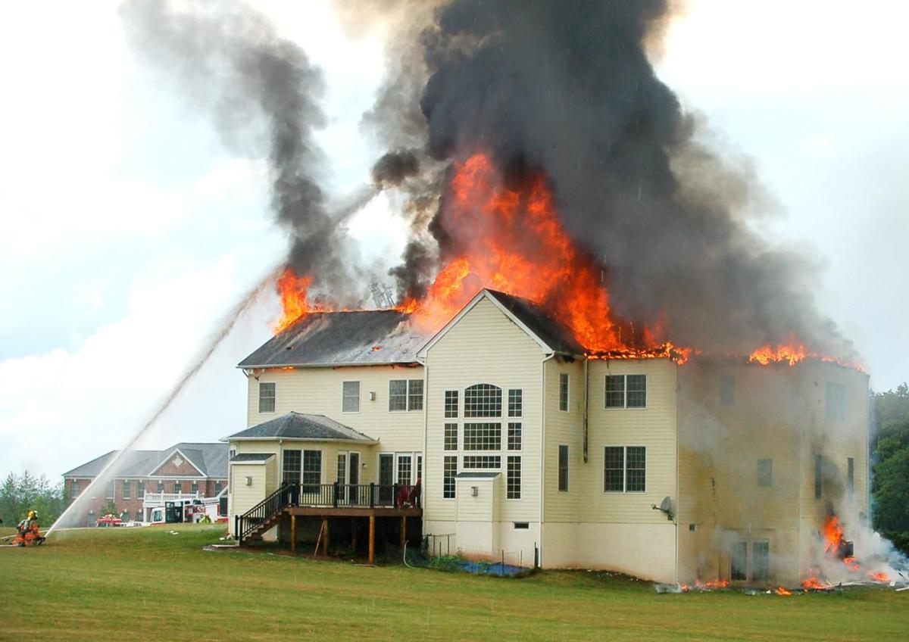

PROBLEMS
Gas Leakage
Fire Accidents
Burglary
Security

Slide 6
Software used
Arduino IDE
Hardware used
Arduino UNO

Slide 7
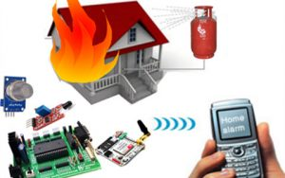
Components Required
Gas Sensor
Flame Sensor
IR Sensor
Microcontroller
GSM Module
Exhaust Fan
Buzzer

Slide 8
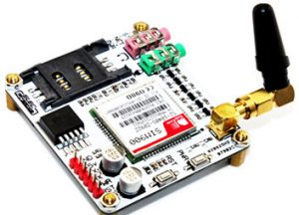
GSM Module

Slide 9
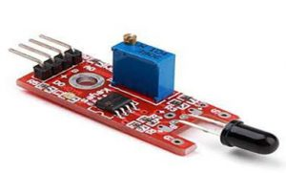
Flame sensor

Slide 10
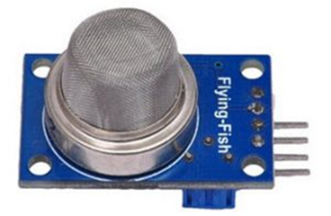
Gas Sensor

Slide 11
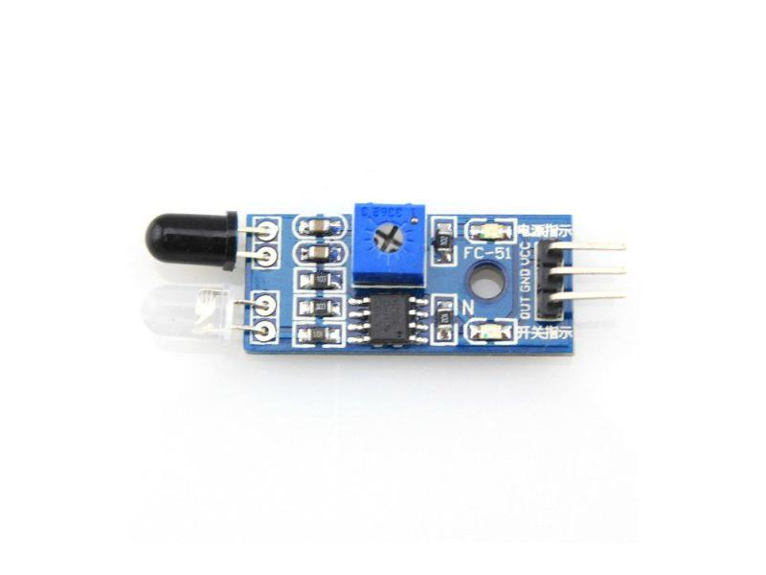
IR Sensor

Slide 12
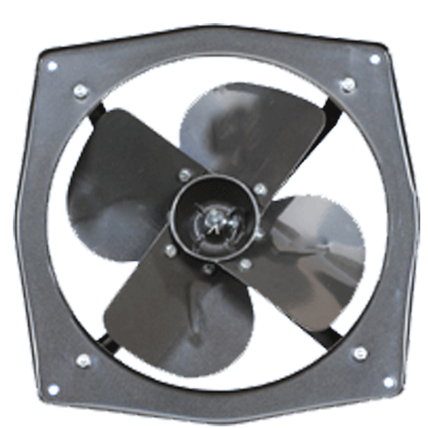

Gas
Sensor
Micro
Controller
Flame
Sensor
GSM Module
LCD Module

Slide 13

IR
Sensor
in
Real Time Clock
Module
Micro
Controller
IR
Sensor
out
GSM Module
LCD Module

Slide 14
Advantages
With the use of this system, the possibility of burglary gets decreased effectively.
It informs via SMS whenever detection of gas leakages or fire takes place and also take required measures like switching on exhaust fan, water source and closing gas regulator,
Fully automated and digital.
With the introduction of automatic system, the energy consumption of motor can be minimized.
This system helps to monitor the current status of the house anytime via LCD module.
Give alarms via buzzer in the house whenever an issue detected.
It detects the water leakage or running taps and give alarm to the user.
Low maintenance of the system.

Slide 15
THANK YOU
- Kowsyap Pranay.M
Ajay.D
Sreemukhi.M
Sadhana.G

